Slide 1
Mobile App for direct Market Access for Farmers
CSE7101- Capstone Project
Review-1
Batch Number : pscs_281
Roll Number | Student Name
20221CDV0001 | Suman S
20221CDV0009 | p.Lakshmi Narashimha
20221CDV0013 | Wasim akram
Under the Supervision of,
Ms.Shana Aneevan
Assistant Professor
Mr.Anadhan B
School of Computer Science and Engineering
Presidency University
Name of the Program: CDV
Name of the HoD: Dr. Pravinthraja S
Name of the Program Project Coordinator: Dr. H M Manjula
Name of the School Project Coordinators: Dr. Sampath A K , Dr. Geetha A

Slide 2
Problem Statement Number:
Organization: Ministry of Agriculture and Farmers Welfare
Category : Software
Problem Description:
Financial Disadvantage: Middlemen dictate prices, cutting into farmer profits.
Information Gap: Farmers lack real-time data on market prices and demand.
Inefficient Supply Chain: The long chain leads to post-harvest waste and spoilage.
Limited Financial Access: Cash-based transactions prevent farmers from building a formal credit history.
Low Price Discovery: Farmers have no mechanism to negotiate prices or find the best buyer for their produce

Slide 3
Content:
Problem Statement
Objectives
Background and Related work for title Selection
Analysis of Problem Statement
Innovation or Novel Contributions
Git-hub Link
Timeline of the Project
References

Slide 4
Problem Statement
Farmers are forced to sell their produce at low, dictated prices to middlemen, leading to minimal profits that barely cover their costs.
Farmers lack access to real-time market prices, demand, and consumer preferences, which prevents them from making informed decisions about what to grow and when to sell.
The traditional supply chain is long and fragmented, with multiple intermediaries, leading to significant delays and physical post-harvest losses.
Farmers have no platform to negotiate prices or compare offers, forcing them to accept the first price they are given without knowing its fairness.
Farmers largely operate on a cash-based system with no formal transaction history, making it difficult to access institutional credit and loans from banks.

Slide 5
Objectives
*Financial Empowerment: Increase farmers' income by eliminating middlemen.
* Price Transparency: Provide fair pricing through direct market access and real-time data.
* Supply Chain Efficiency: Reduce post-harvest losses with streamlined logistics.
* Wider Market Access: Connect rural farmers to a broader consumer base.
* Financial Inclusion: Help farmers build a credit history through digital transactions.
* Build Trust: Foster direct relationships between farmers and consumers.

Slide 6
Background and Related work for title Selection
* Financial Exploitation: Middlemen dictate prices, cutting into farmer profits and leading to debt
* Information Gap: Farmers lack real-time data on market prices and consumer demand.
* Inefficient Supply Chain: The long chain causes significant post-harvest waste and spoilage.
* Lack of Transparency: Consumers cannot verify food origin, leading to a lack of trust.
* Limited Financial Access: Cash-based sales prevent farmers from building a formal credit history.
* No Direct Communication: The absence of a direct channel hinders feedback and trust between producers and consumers.

Slide 7
Analysis of Problem Statement
Technology Stack Components:
1. Frontend (User Interface)
HTML5 / CSS3 – for designing web page layout and styling.
JavaScript – for making the web app interactive.
Flutter- quick prototyping and debugging in a web app
2. Database
MySQL / PostgreSQL – for storing data like farmer records, wool batches, processing stages, etc.
3.Optional Features
Data Analytics Tools – for insights on wool tracking, supply chain metrics, etc.
Mobile App (Optional) – can be built using React Native or Flutter.
Cloudhosting- focus on app development

Slide 8
Innovation or Novel Contributions
* Holistic Solution: The app's key innovation is its integrated approach to addressing the entire agricultural value chain, from providing market information to facilitating direct sales and managing logistics.
* Empowering Farmers: It transforms farmers from passive price-takers into active "micro-entrepreneurs" by giving them the tools to set their own prices and manage their business.
* Building Trust: The platform's direct producer-to-consumer connection is a novel way to build trust and transparency in the food supply chain.
* Financial Inclusion: By digitizing transactions, the app helps farmers build a formal financial history, enabling them to access institutional credit.
* Scalable Community Model: It establishes a model that can be scaled to connect diverse farmers and consumers, creating a more sustainable and equitable food system.

Slide 9
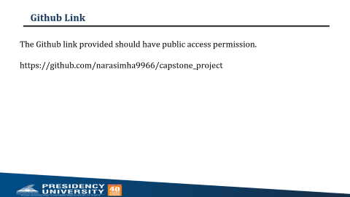
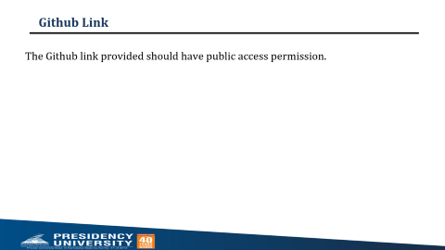
Github Link
The Github link provided should have public access permission.
https://github.com/narasimha9966/capstone_project

Slide 10
Analysis of Problem Statement (contd...)
Software and Hardware Requirements:
Software:
Operating System: Windows 10 or later / Linux / macOS
Frontend Technologies: HTML5, CSS3, JavaScript, React.js or Angular
Database: MySQL / PostgreSQL / MongoDB
Development Tools: Visual Studio Code / PyCharm / WebStorm
Version Control: Git and GitHub / GitLab
Web Server: Apache / Nginx
APIs: RESTful APIs for data exchange
Cloud Services (Optional): AWS / Firebase / Heroku for hosting
Authentication: JWT (JSON Web Tokens) or OAuth 2.0

Slide 11
Analysis of Problem Statement (contd...)
Hardware:
Development Machine: Laptop or desktop with minimum 8GB RAM, 256GB SSD, and a modern processor
Server (Optional): Cloud server or dedicated server for hosting the application
Internet Connection: Stable broadband connection for deployment and remote access
Client Devices: Smartphones, tablets, or computers for end-users to access the application

Slide 12
Timeline of the Project (Gantt Chart)
Week 1–3: Project initiation & requirement analysis
Week 4–6: Curriculum design & content development
Week 7–9: Infrastructure setup & training
Week 10–12: Pilot implementation & evaluation
Week 13–15: Final deployment & project closure

Slide 13
References (IEEE Paper format)
Mobile App for Direct Market Access for Farmers" by K. Sughasini et al. (2024). This paper discusses the development and implementation of a mobile app to connect farmers and consumers, focusing on features like a user-friendly interface, real-time price negotiation, and transaction management. It's a highly relevant direct reference.
link: JETIR2412104.pdf

Slide 14


